Slide 1
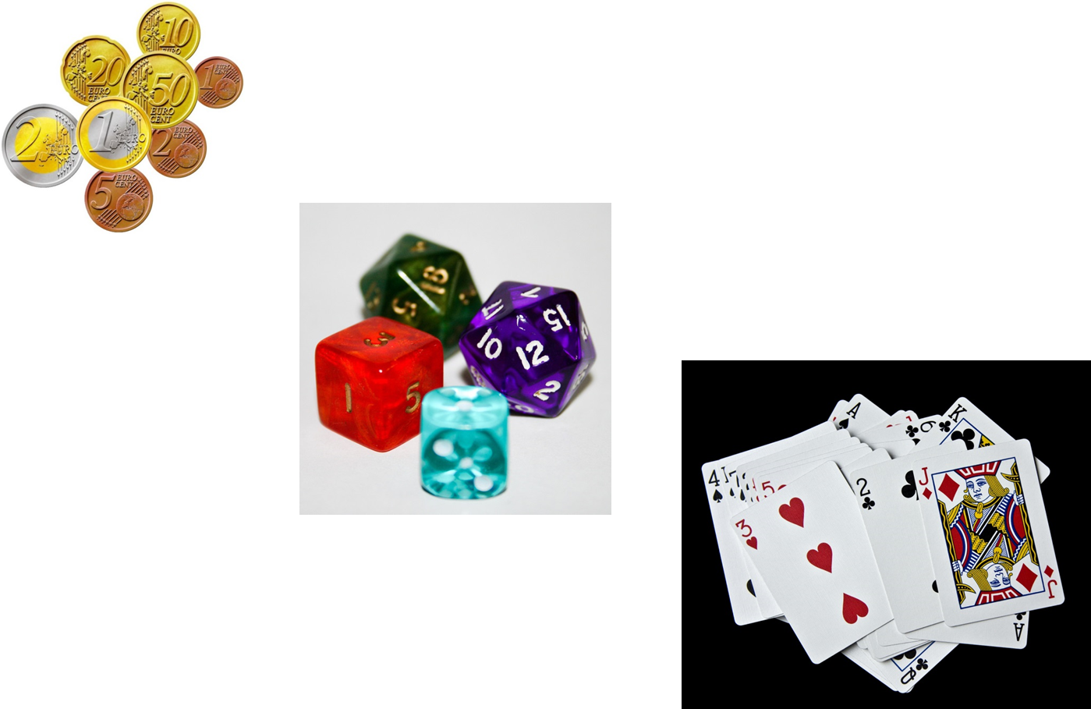
Topic: Probability
EQ: How do we find probabilities from two way tables, venn diagrams and tree diagrams?
Start: Do times tables grid!

Slide 2
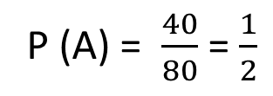
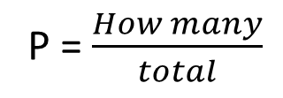
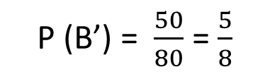
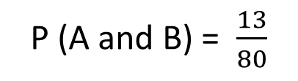
24
7
30
Date
Probability
EQ – How do we find probabilities from two way tables, venn diagrams and tree diagrams?
What is a two-way table?
Two-way tables lists the number of outcomes in different categories, with totals at the bottom.
We display them like this.
Not A
 |  | Event A
 |  | A | A’ | Total
Event B | B
 | B’
 | Total
13
17
30
27
23
50
40
40
80
How do we find probabilities?
P = $\frac{How many}{total}$
P (A) = $\frac{40}{80}$ = $\frac{1}{2}$
P (A and B) = $\frac{13}{80}$
P (B’) = $\frac{50}{80}$ = $\frac{5}{8}$
7

Slide 3
Topic: Probability
EQ – How do we find probabilities from two way tables, venn diagrams and tree diagrams?
EQ: HHow do we find probabilities from two way tables, venn diagrams and tree diagrams?ow do we find probabilities from two way tables, venn diagrams and tree diagrams?
Let’s make a two way table on how the class feels about pineapple and anchovy on pizzas!
 | Likes pineapple | Doesn’t like pineapple | Total
Likes anchovy
Doesn’t like anchovy
Total
Answer the probability questions:
P(likes pineapple)=
P(doesn’t like anchovy)=
P(likes pineapple and anchovy)=
P(doesn’t like anchovy and pineapple)=
What is the probability that someone doesn’t like pineapple, given that they like anchovy?

Slide 4
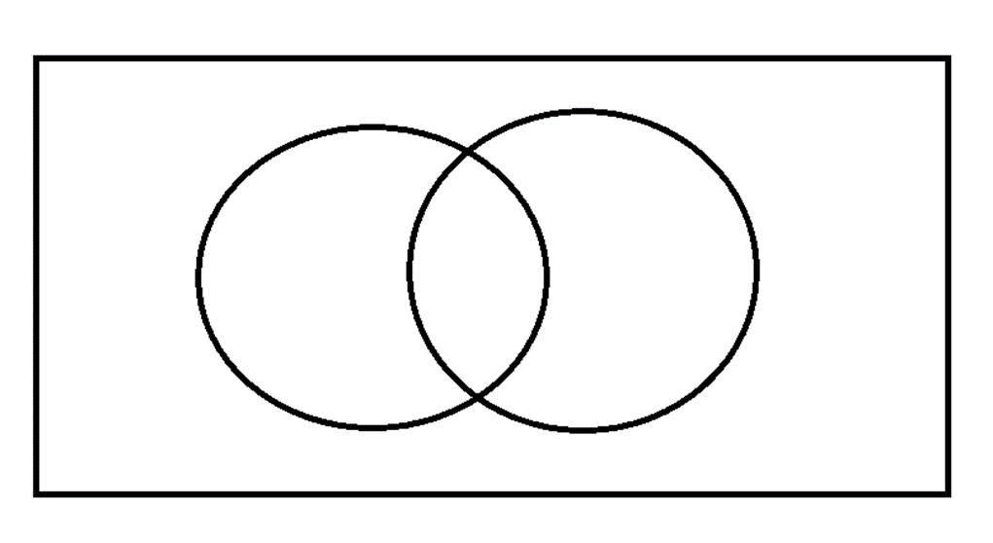
24
7
30 Probability
Date
EQ – How do we find probabilities from two way tables, venn diagrams and tree diagrams?
A Venn diagram is
a pictorial representation using overlapping circles showing the number of objects in two or more categories.
We can use them to find probabilities.
A two-way table can be written as a Venn diagram, without the row and column totals
What is a Venn Diagram?
Let’s do one as a class and answer some probability questions!
5

Slide 5
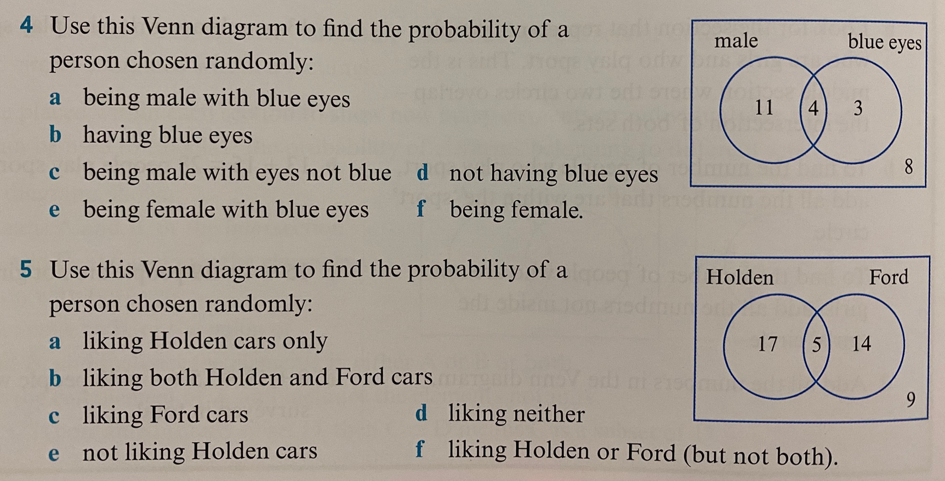

Slide 6
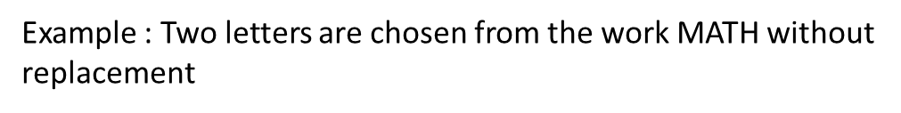
24
7
30
Date
Tree Diagrams
EQ – How do we find probabilities from two way tables, venn diagrams and tree diagrams?
What are tree diagrams?
Tree diagrams list the sample space for multistage experiments
Outcomes for each stage are listed vertically
Each stage connected with branches
9

Slide 7
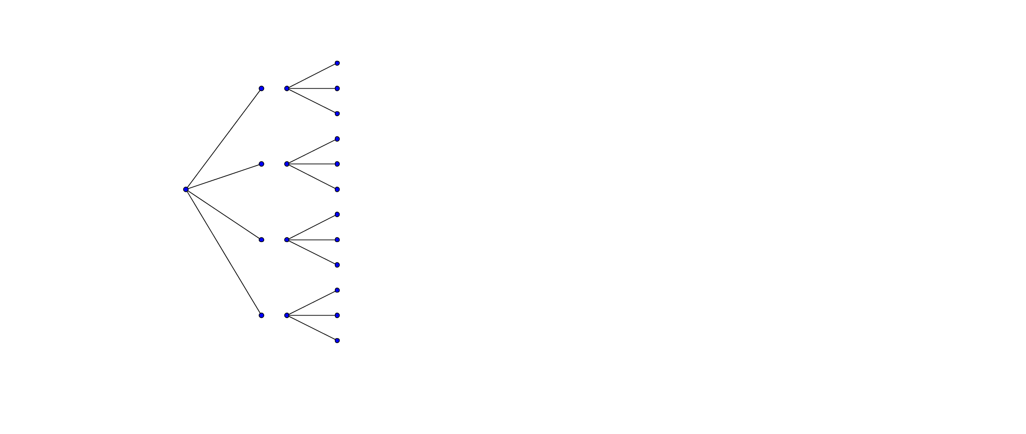
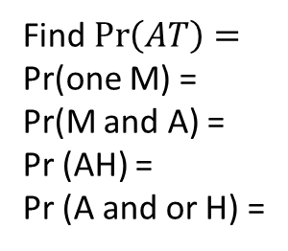
24
7
30
Date
Tree Diagrams
EQ – How can I list the outcomes for multiple events?
Example : Two letters are chosen from the work MATH without replacement
2nd Letter
Outcomes
1st Letter
A
T
H
M
T
H
M
A
H
MA
T
MA
MT
MH
AM
AT
AH
TM
TA
TH
HMHA
HT
M
Find $\operatorname{Pr}\left(AT\right)=$
Pr(one M) =
Pr(M and A) =
Pr (AH) =
Pr (A and or H) =
A
12
Outcomes
T
H
9

